Slide 1
Best Actor Detection
GEORGIA STATE UNIVERSITY
Dhruval Patel
Advisor: Dr. Murray Patterson

Slide 2
Introduction
What factors contribute towards making a movie successful?
A compelling storyline
A well written script
Talented editors, photographer, videographer, etc.
Actors
Actors
One of the main and most important factor
Some audience will watch a movie no matter how the script is if it contains their favorite actor.
Example: Dwayne Johnson, Will Smith, Tom Holland, Jennifer Lawrence

Slide 3
Motivation
Given
Actor: Movies that they have worked in, gender, etc.
Movie: Box office revenue, language, country of release, etc.
Predict/Discover
An actor who might make a successful movie
Utilize similarity measures
Find popular pairs of actors who will make a successful movie
Utilize similarity measures
Does working in a lot of movies make you popular or result in a successful movie?

Slide 4
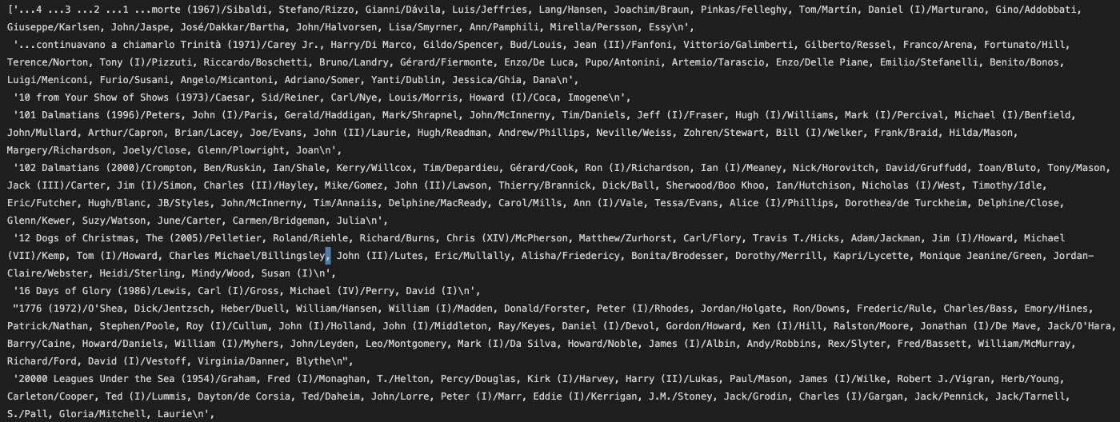
Dataset #1
Only contains movies and the actors
Format: [Movie name/Actor#1/Actor#2/…../Actor#n]

Slide 5
Dataset #2
Movie metadata
Wikipedia movie ID
Movie box office revenue
Movie languages
Other info: Freebase movie ID, Movie name, Movie release data, Movie runtime, Movie countries, Movie genres
Character metadata
Wikipedia movie ID
Actor gender
Actor name
Other info: Freebase Movie ID, Character Name, Actor DOB, Actor Height, Actor ethnicity, Actor age at movie release, Freebase character map
Plot Summary

Slide 6
Pre-Processing: Graph Formation
Nodes: Actors
Edges: Common movies
One movie = One clique
Edge weight: Number of common movies
Dataset #1
Edges: 1.4M+
Nodes: 21k+
Dataset #2
Edges: 2.08M+
Nodes: 133k+

Slide 7
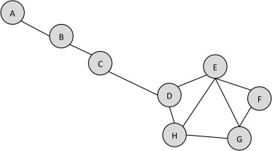
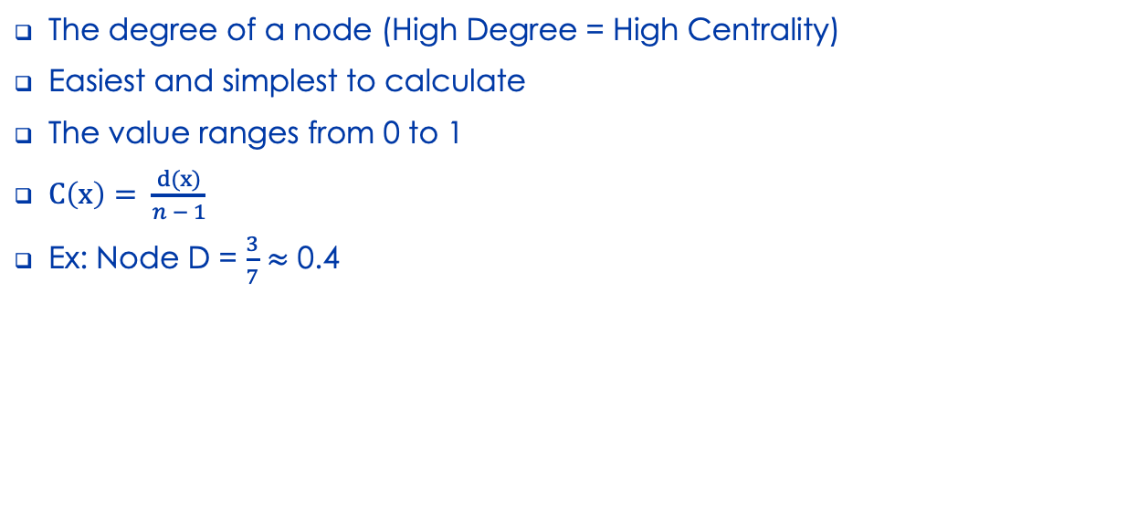
Algorithms: Degree Centrality
The degree of a node (High Degree = High Centrality)
Easiest and simplest to calculate
The value ranges from 0 to 1
$C\left(x\right)= \frac{d(x)}{n − 1}$
Ex: Node D = $\frac{3}{7}≈$ 0.4

Slide 8
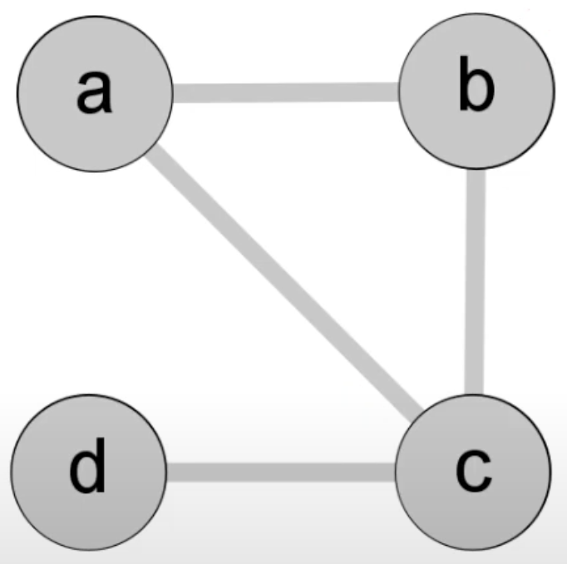
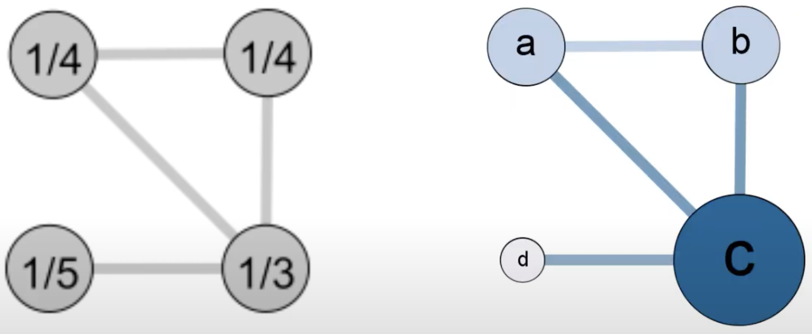

Algorithms: Closeness Centrality
Indicates how close a node is to other nodes
Reciprocal of the sum of the length of the shortest paths between the node and all other nodes in the graph
$C\left(x\right)= \frac{1}{\sum_{y}{d(x, y)}}$ (d(x, y) is the shortest distance between x and y)
Ex:

Slide 9
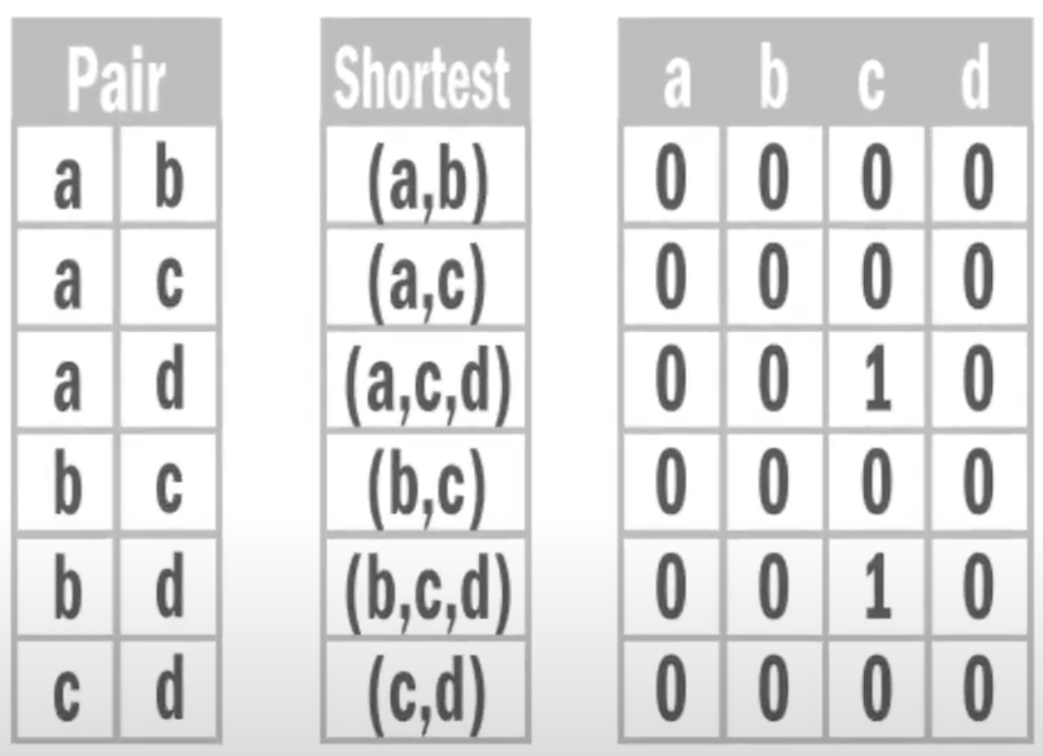
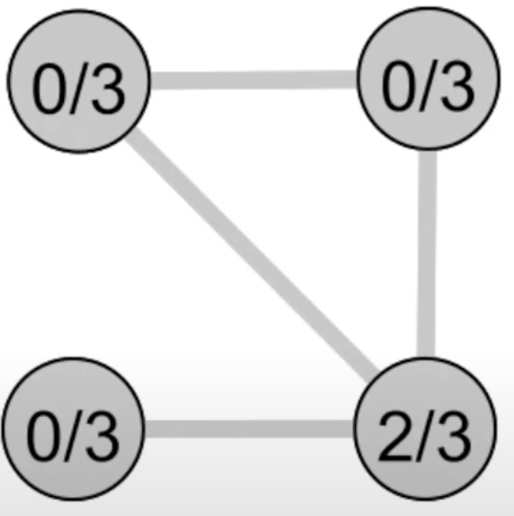

Algorithms: Betweenness Centrality
Measure of centrality in a graph based on popularity and shortest paths
Captures a node’s role in allowing information to pass from one part of the network to the other
Normalized betweenness centrality of node v can be represented as
$c\left(v\right)= \frac{p(v)}{(n−1)(n−2)/2}$ (p(v): Popularity of node v)

Slide 10
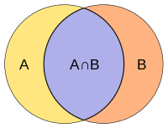
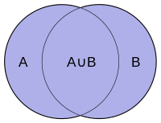

Algorithms: Jaccard Coefficient
Used for gauging the similarity and diversity of sample sets
The value ranges from 0 to 1 (Higher is better)
$J\left(A, B\right)= \frac{Intersection}{Union}=\frac{|A∩B|}{|A∪B|}$

Slide 11
Threshold
Number of nodes and edges is very high creating difficulties for graph visualization, calculating centrality measures and Jaccard Coefficient similarity for a pair of actors
Outlier detection: Unpopular actors (Worked in very small number of movies)
Dataset 1
Visualization: Edge weight > 5 and Node degree > 2
Edges: 125 edges and 51 nodes
Centrality and JC: Edge weight > 2 and Node degree > 2
Edges: 8432 edges and 1519 nodes
Dataset 2
Visualization: Edge weight > 10 and Node degree > 10
Edges: 157 edges and 54 nodes
Centrality and JC: Edge weight > 4 and Node degree > 2
Edges: 10552 edges and 2742 nodes

Slide 12
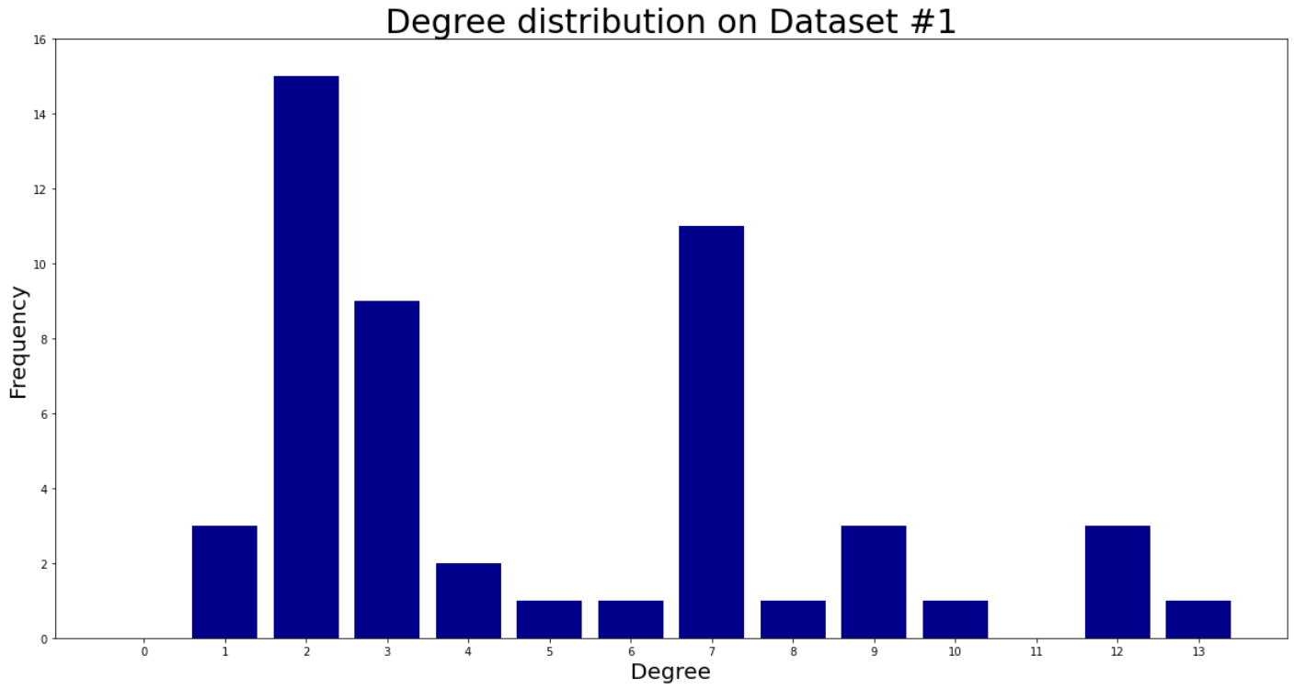
Visualization: Degree Distribution

Slide 13
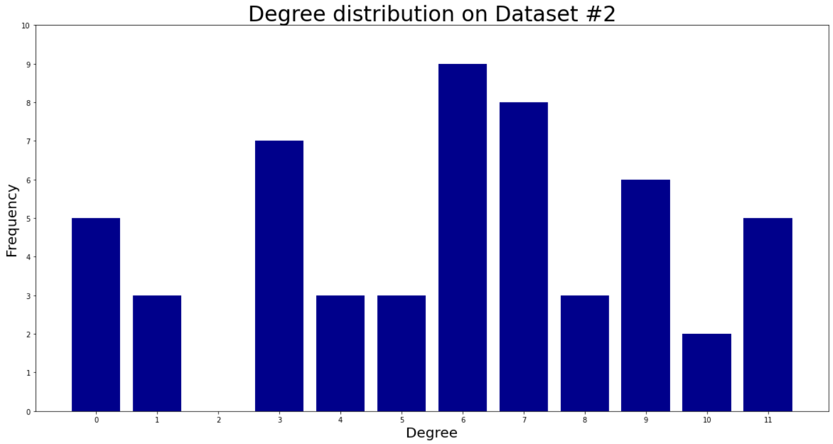
Visualization: Degree Distribution

Slide 14
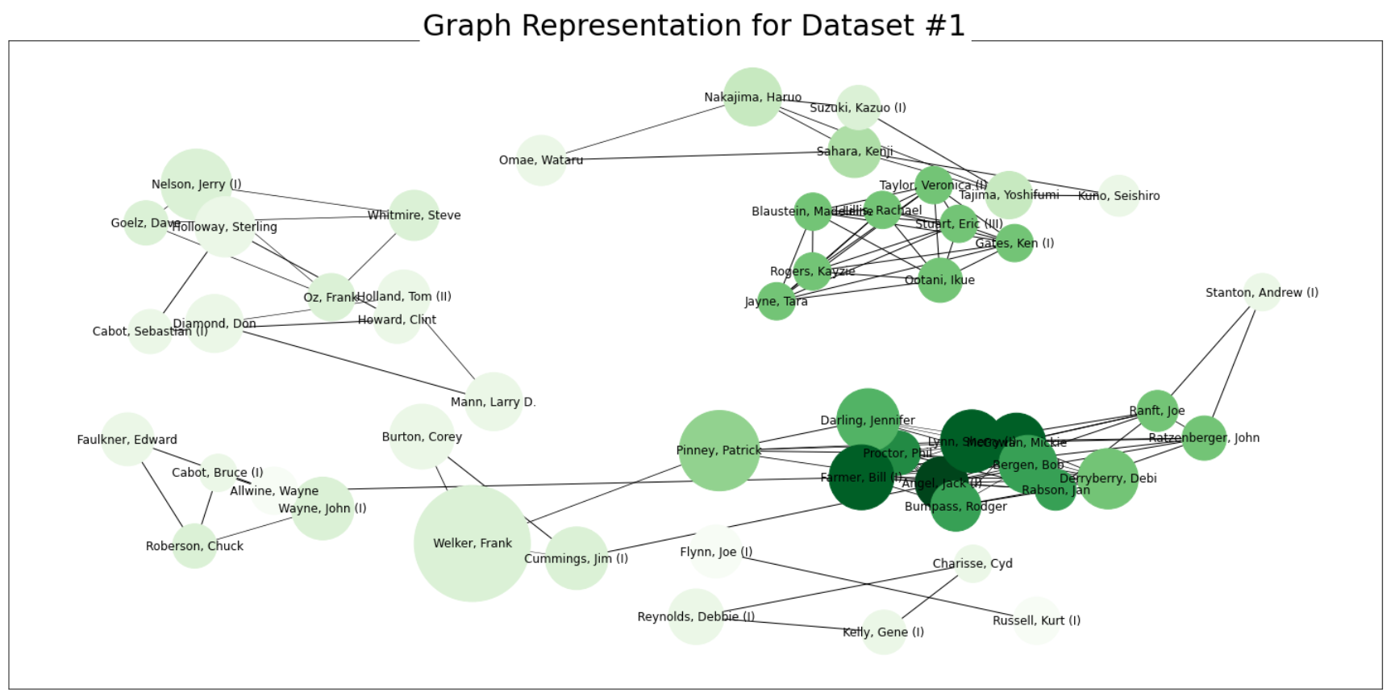
Visualization: Graph Representation

Slide 15
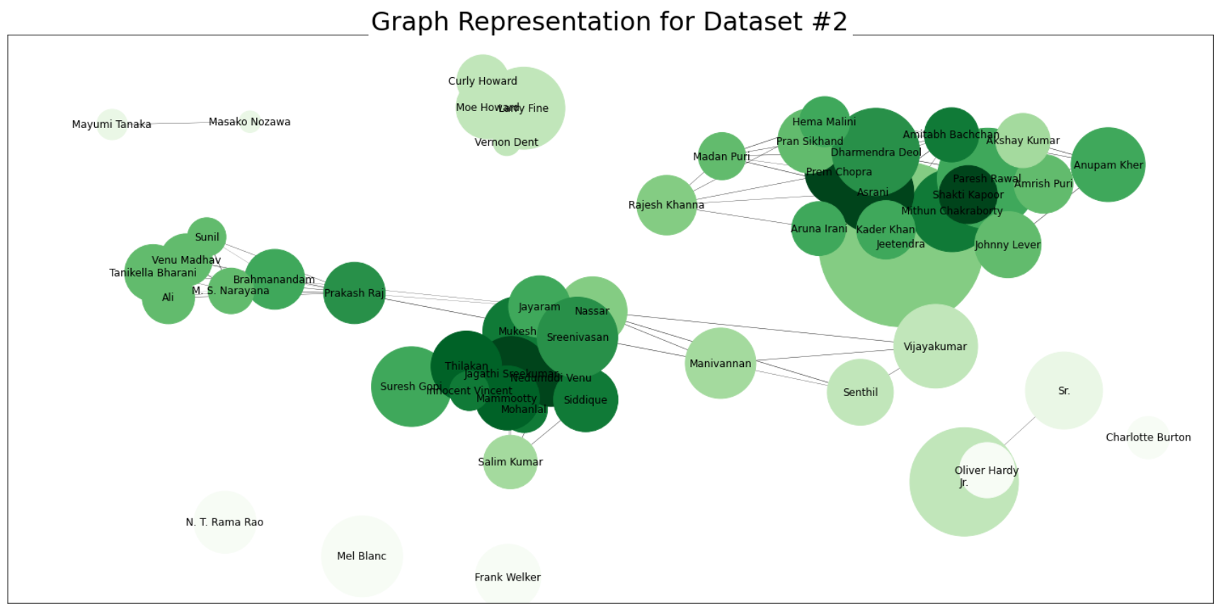
Visualization: Graph Representation

Slide 16
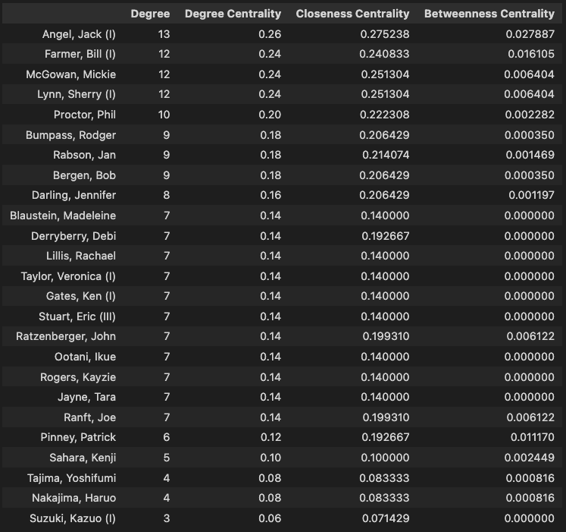
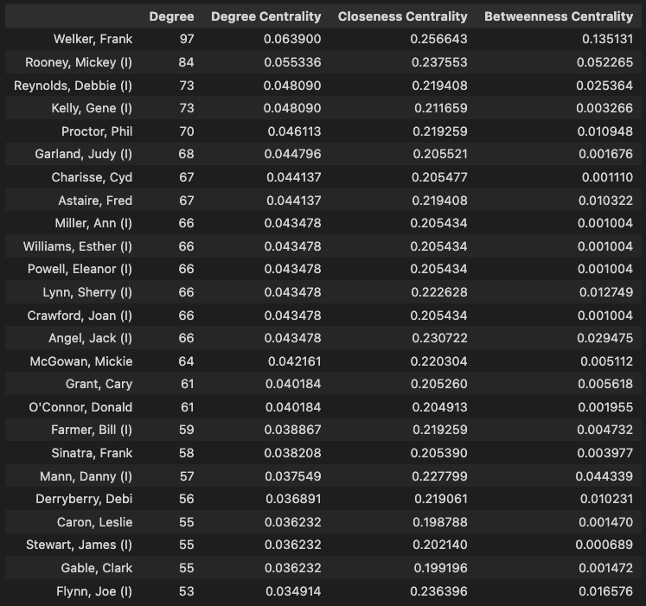
Experimental Values: Centrality
Dataset #1
Threshold: Edge weight > 5 and node degree > 2
Threshold: Edge weight > 2 and node degree > 2

Slide 17
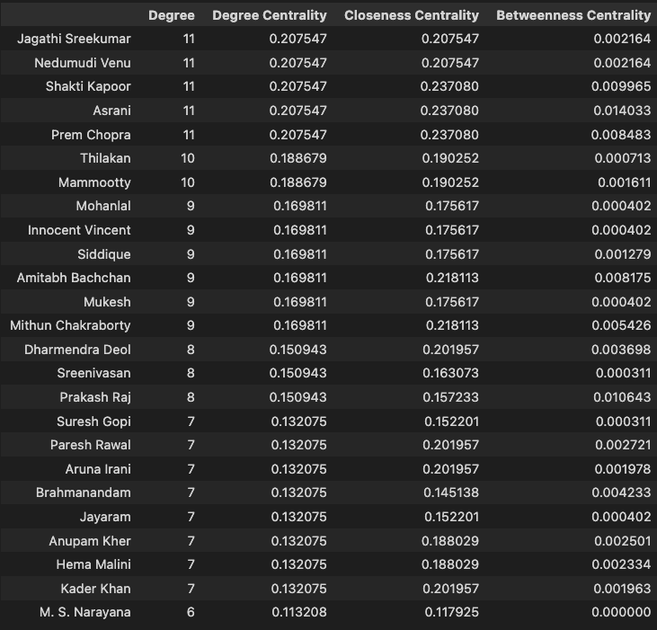
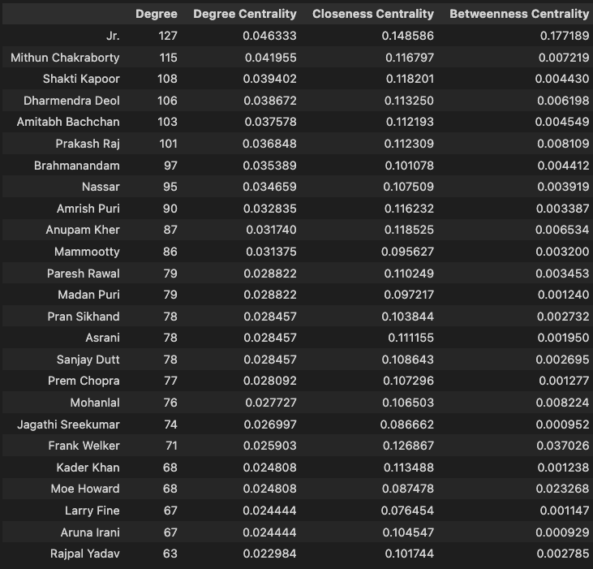
Experimental Values: Centrality
Dataset #2
Threshold: Edge weight > 10 and node degree > 10
Threshold: Edge weight > 4 and node degree > 2

Slide 18
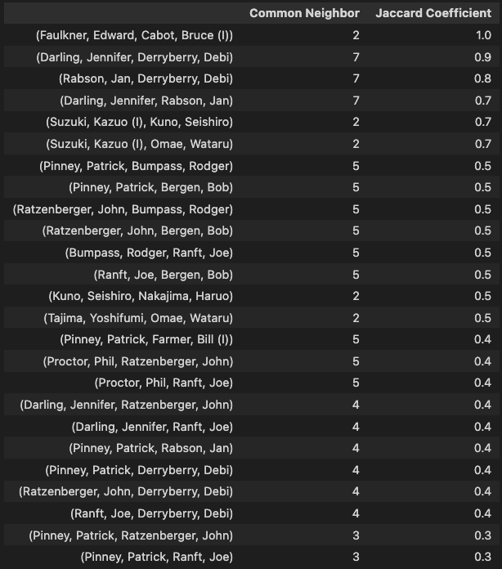
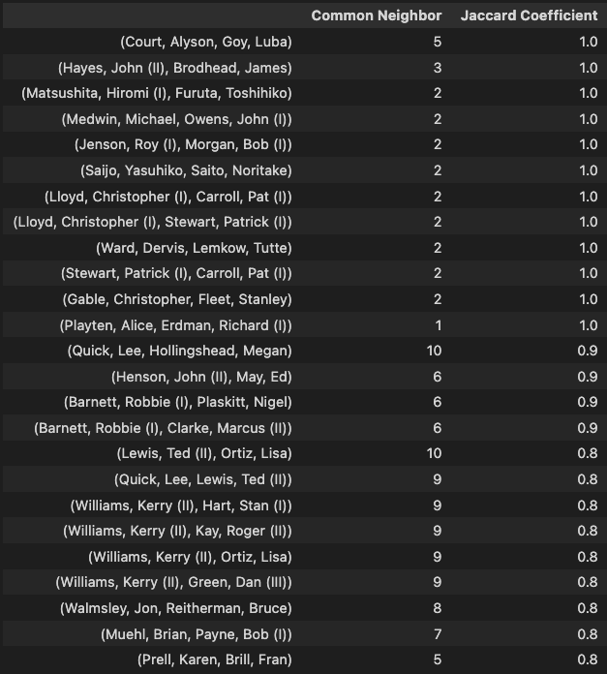
Experimental Values: Jaccard Coef.
Dataset #1
Threshold: Edge weight > 5 and node degree > 2
Threshold: Edge weight > 2 and node degree > 2

Slide 19
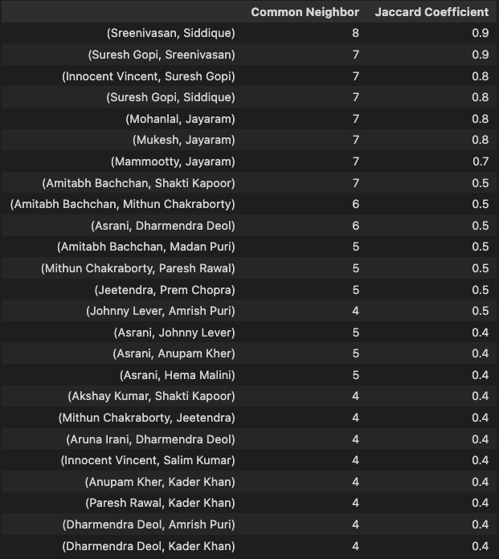
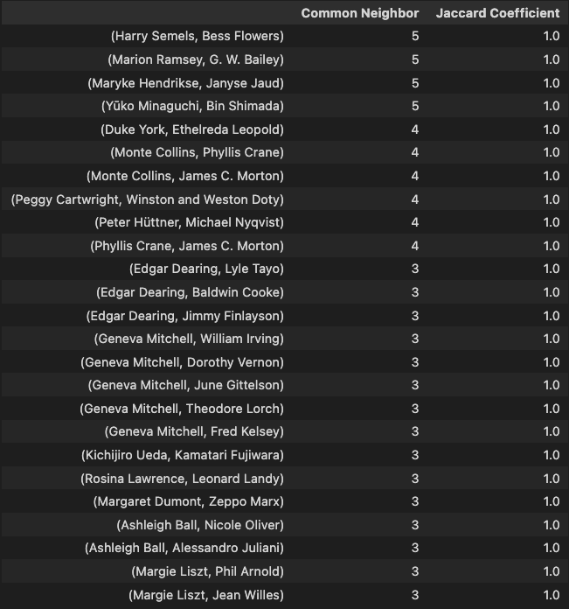
Experimental Values: Jaccard Coef.
Dataset #2
Threshold: Edge weight > 10 and node degree > 10
Threshold: Edge weight > 4 and node degree > 2

Slide 20
Data validation
Review:
Degree Centrality
Closeness Centrality
Betweenness Centrality
Jaccard Coefficient
Is this enough?
How can we justify that the Centrality and Jaccard Coefficient reflects an actor's success?

Slide 21
Scripts: Actor-Gender
Extracted actors and their genders from character.metadata.tsv
Total male actors: 60,759
Total female actors: 35,657
Is a pair of male actors, female actors or a pair of male and female actors better?
Utilized Jaccard Coef. Values
Pair of male actors: 1,738,212
Pair of female actors: 330,313
Pair of male and female actors: 1,529,922
Male actors bring higher chance of making a movie successful

Slide 22
Scripts: Movie-Revenue
Extracted movie and their box office revenue that it generated from movie.metadata.tsv
Extracted a dictionary of actors and all the movies that they worked in
Summed up the revenue of each movie that was generated for each actor
Drawbacks: Missing box office revenue for a lot of movies

Slide 23
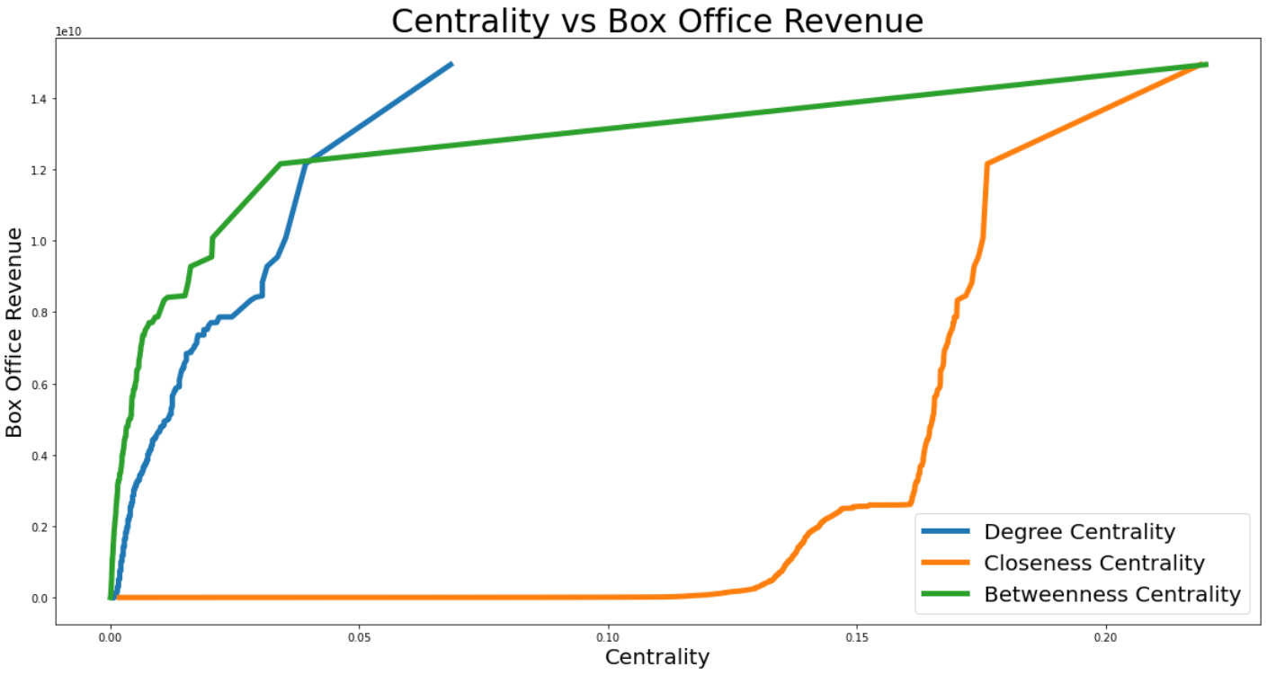
Data Validation
Can we justify that the Centrality and Jaccard Coefficient reflects an actor's success?
Pair of male actors: 1,738,212
Pair of female actors: 330,313
Pair of male and female actors: 1,529,922
Threshold:
Edge weight > 3
Node degree > 3

Slide 24
Summary
Utilized two datasets:
Dataset 1: Actors and Movies
Dataset 2: Movie metadata and Character metadata (Used for validation)
Similarity measures performed:
Degree Centrality, Closeness Centrality, Betweenness centrality
Jaccard Coefficient
Data validation:
Centrality: All centrality measure and box office revenue have a correlation
JC: Found that male actors tend to have a higher chance of making a movie successful
Does working in a lot of movies make you popular or result in a successful movie?
NO!

Slide 25
Visualization: Graph Representation

Slide 26
Future Work
Better dataset
Less missing values
Newer actors
Dataset #2 can be further studied
Implement more algorithms
Community Detection: Find communities with a country, genres, language, and many more.

Slide 27

Questions?

